Slide 1

Shri Vaishnav Vidyapeeth Vishwavidyalaya
Shri Vaishnav Institute of Information and Technology
Department of Information Technology
Session January-June 2022
Automated Wheelchair
Presented By:-
Branch: IT-B
Subject: Internet of Things
[BTIT502]
Submitted To: Prof. Richa Jain
Rishika Jain [19100BTIT6604]
Sabiha Bee [19100BTIT6606]
Shraddha Vishwakarma [19100BTIT6613]
Shristi Sisodiya [19100BTIT6615]

Slide 2
Contents
Introduction
Application | Objective | Components
DFD
Advantages | Future Scope | Conclusion

Slide 3
Introduction
The aim of this project is to use wheelchair automatically for moving forward, backward, Left & Right. The overall framework of this project is to restore autonomy to severely Disabled people by helping them use independently a power wheelchair.
A wheelchair is an electric wheelchair fitted with acceleration sensors, obstacle sensor and computer to help less able drivers achieve some independent mobility. By just tilting acceleration sensor wheelchair can be moved in four directions.
The obstacle sensor can help the rider control the wheelchair by taking over some of the responsibility for steering and avoiding objects until he or she is able to handle the job. The amount of work that the rider chooses to do and how much control is taken by the chair is decided by the rider and his or her care. Obstacle in the way can be determined by wheelchair and wheelchair will stop automatically

Slide 4
Objectives of Automated Wheelchair
Application of Automated Wheelchair
Hostels
Health care centers
Old age home
Physically Impaired
Sports
Automatic gaming toys.
Communication
Control of Mechanical systems
In industries as robot to carry goods.
Automated wheelchairs that are equipped with sensors & data processing unit are termed as Smart Wheelchair. Our goal is to design and develop a system that allows the user to robustly interact with the wheelchair at different levels of the control and sensing
Components
Aurdino UNO
Keypad
Ultrasonic Sensors
Buzzer
Motor Driver L293D
Motors
Battery Of 12V
Chassis
Bluetooth Module(L293d)
Chair

Slide 5
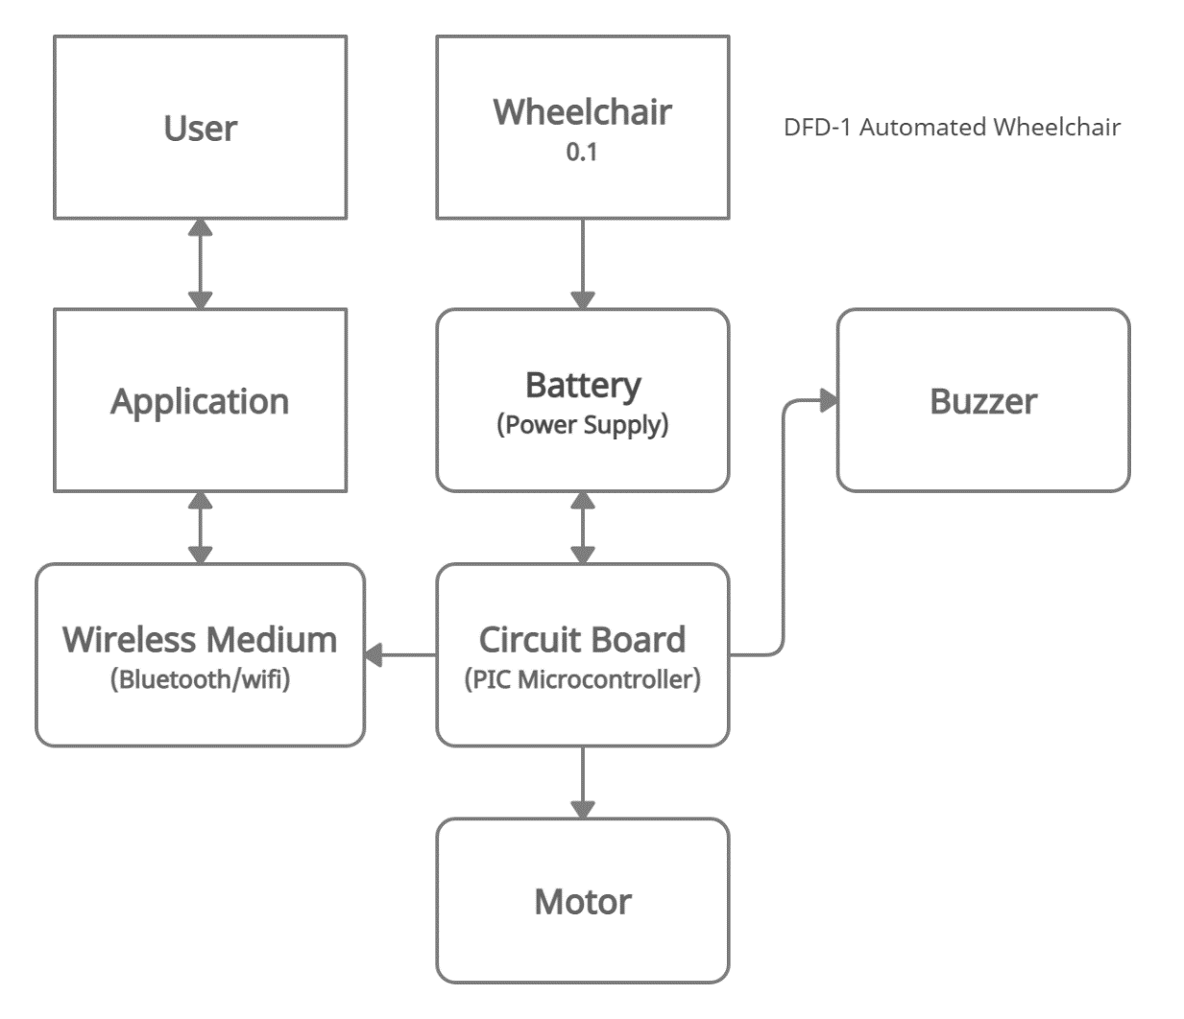
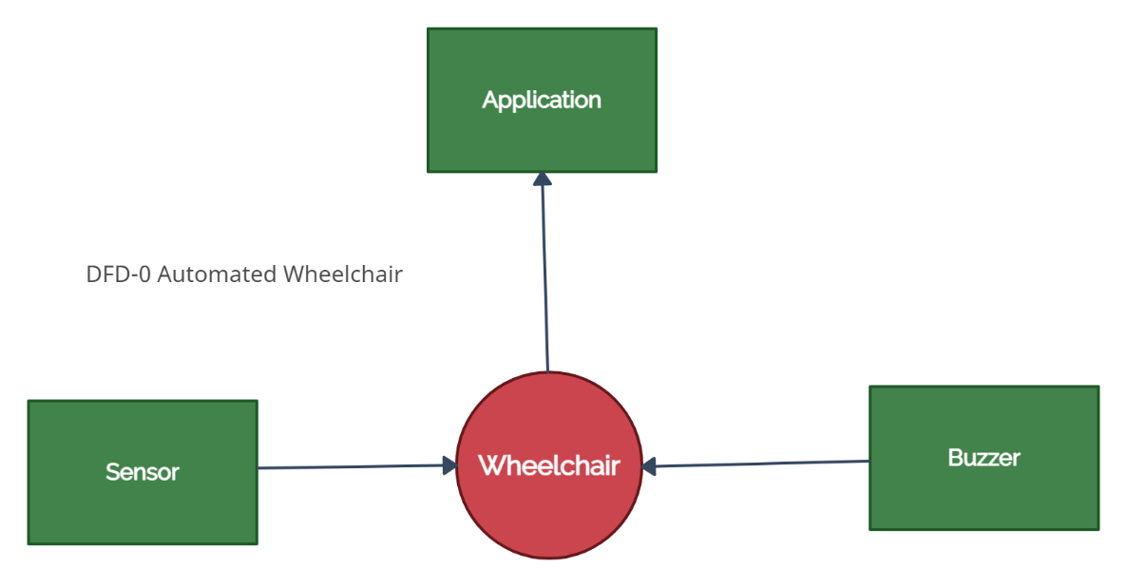
Data Flow Diagram

Slide 6
Conclusion
Advantages
The wheelchair detects the obstacle at the front and stop the movement within a range of 50 CMs.
Without any external help the paralyzed person can operate his own chair.
The prototype of the system is successfully developed to move the wheelchair Left, Right, Forward, and Backward directions or stay in the same position.
Future Scope
The structure is modified in accordance with create it for the external condition by modifying the GPS space and therefore the client will decide on call to encounter it. The opposite means is that the means are going to be secured because the video and therefore the chair will travel naturally by perceiving totally different past patterns. Research is going on development of handicap wheelchair using nervous system of human
Implemented wheelchair covers more and useful functionalities in efficient way compared to other existing wheelchairs. This Intellectually Automated Wheelchair is a good solution for handicapped, blind, paralyzed as well as aged people. It is energy efficient due to solar panels also a good communication service in case of emergency.

Slide 7
REFERENCES
www.google.co
www.wikipedia.org
www.google.co.in.imghp
www.books.google.co.in

Slide 8

THANK YOU

